Slide 1
Add some Sizzle
Week 15

Slide 2
Like what?
Add an additional API to collect and present some additional data
Current weather for the location
List of nearby restaurants
Local attractions
Movies playing close by
Today’s closing stock price for Amazon
UNT’s very own search API
https://digital.library.unt.edu/api/
https://digital.library.unt.edu/search/opensearch/
https://digital.library.unt.edu/search/opensearch/?q=unt&format=json&submit=
Add speech to the app

Slide 3
How about speech?
let speech = new SpeechSynthesisUtterance(); speech.lang = "en-US"; speech.text = "Your unicorn has arrived"; speech.volume = speech.rate = speech.pitch = 1; window.speechSynthesis.speak(speech);

Slide 4
What internal functions could be used? displayUpdate
It takes a single param and creates an <li> element
Whatever text is passed in will be the innerHTML of the <li>
Any kind of HTML can be used

Slide 5
Where might you introduce your code? Ride.js
This is where the interesting client-side code happens
completeRequest
Called when the Request button completes the request
The method has a default param the result from the #.ajax call
For many of my suggestions the location is required

Slide 6
A closer look at $.ajax
Documentation: https://api.jquery.com/Jquery.ajax/
success
Type: Function( Anything data, String textStatus, jqXHR jqXHR )
called if the request succeeds. Receives three arguments:
data returned from the server, formatted according to the dataType parameter
a string describing the status
and the jqXHR object.

Slide 7
Original Code
Original completeRequest handler
success: completeRequest, // passes all 3 params
function completeRequest(result) // only need the 1st

Slide 8
Modified Coe
Updated completeRequest handler
We need more than just the name of the unicorn we need the location
Instead of accepting the defaults we specify what we need
success: completeRequest(result, pickupLocation)
function completeRequest(result, pickupLocation)

Slide 9
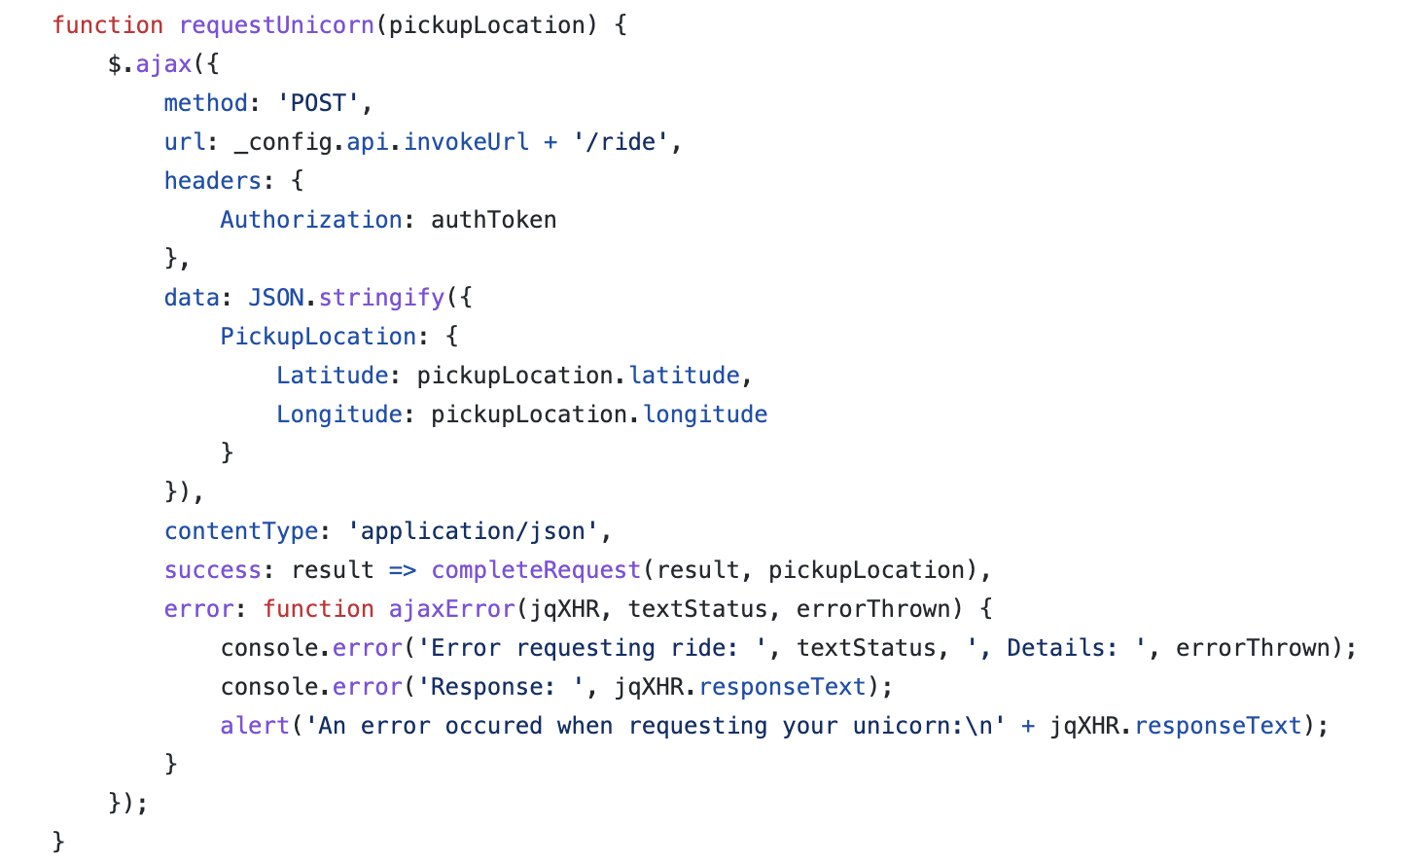
$.ajax request with the response

Slide 10
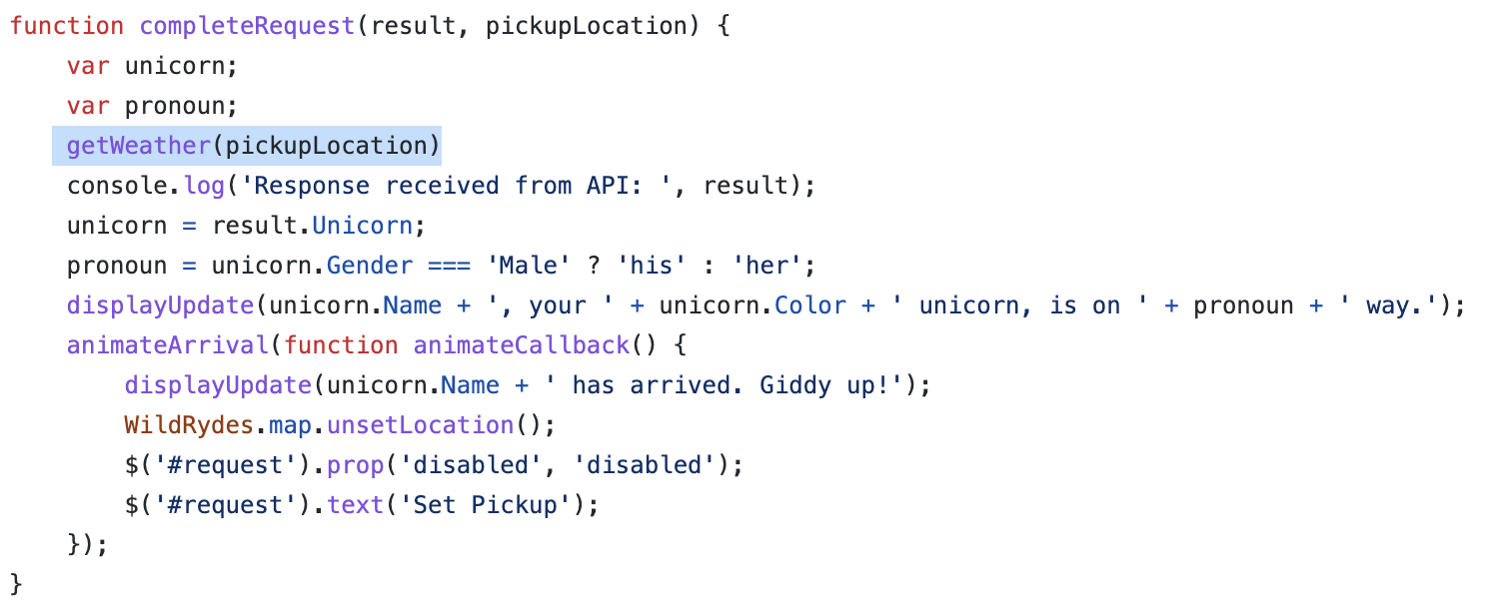
The complete completeRequest function

Slide 11
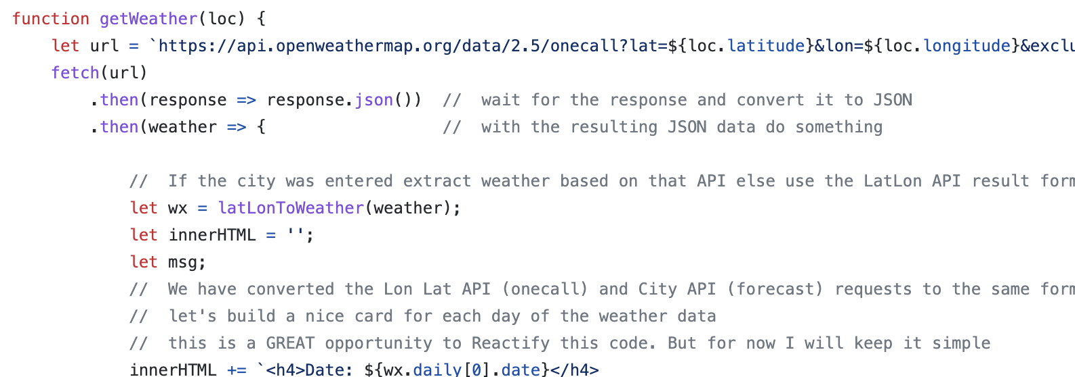
A ‘peek’ at the getWeather function

Slide 12
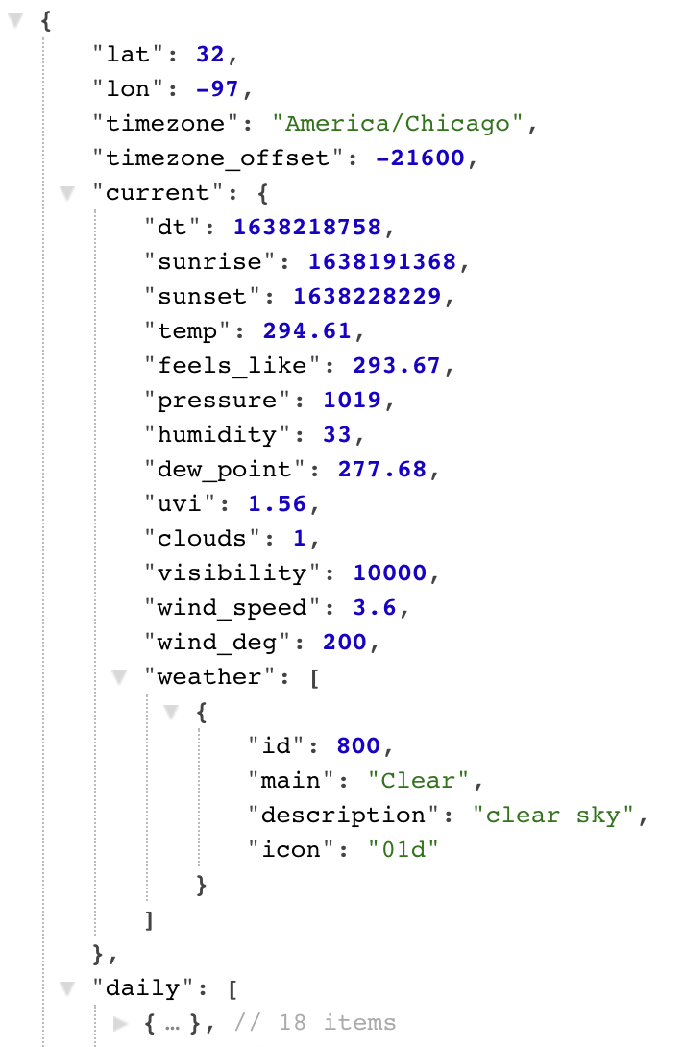
The Weather API
https://api.openweathermap.org/data/2.5/onecall?lat=32&lon=-97&exclude=minutely,hourly&appid=a099a51a6362902523bbf6495a0818aa

